Slide 1
DIP FINAL PROJECT
Team Name: Jougan
Team Members: 20171052(CSE) and 20171105(CSD)
TA Mentor : Abhishek Prusty
ID : 25
TITLE :
Face Illumination Transfer through Edge-preserving Filters
GitHub Link: ( https://github.com/saisoorya2000/DIP_Project )

Slide 2
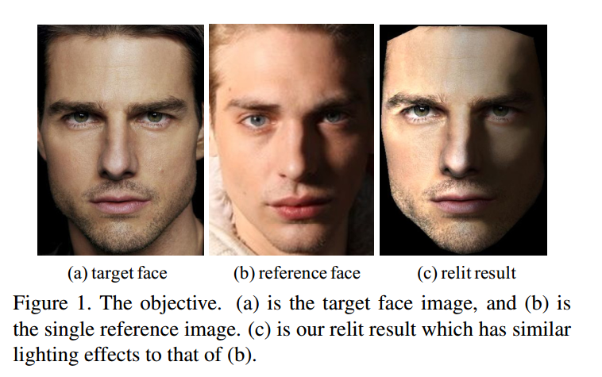
MAIN GOAL OF THE PROJECT
Our Main objective is to generate photo-realistic relighting of a frontal face image taken under nearly uniform illumination, with a single reference face image of different illumination. ( As shown in below figure )

Slide 3
PROBLEM DEFINITION
What is the Problem:
Image-based photo-realistic face relighting from a single reference image without any knowledge of the 3D geometry or material information of the target face.
We first decompose images into two layers: color and lightness, then decompose the lightness layers of the reference and the target images into large-scale (illumination variance) and detail layers(reflectance variance).
We then apply edge-preserving filters to smooth the large-scale layer of the reference image and preserve the edges of the large-scale layer of the target image.

Slide 4
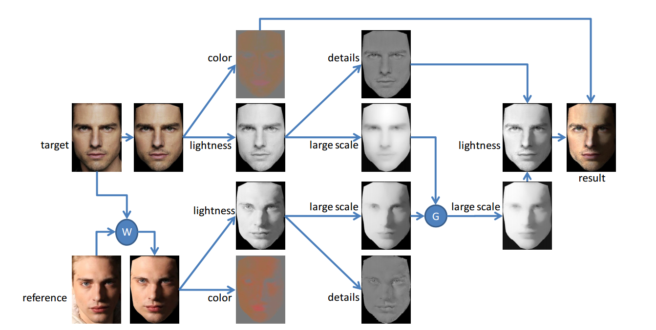
WORKFLOW

Slide 5
Face Illumination Transfer
1)Face Alignment:
We take Active Shape Models mark points as control points to warp the reference image according to the target image by using the affine transform.
2)Layer Decomposition:
We decouple the image into lightness and color layers.
We employ edge-preserving filters such as WLS filter to smooth the lightness layer so as to obtain the large-scale layer and then use division to obtain the detail layer.
3)WLS filter with Adaptive Parameter:
In our task when WLS filter is used it is expected to perform different levels of smoothing on different regions of the image thus we set different smooth levels in different regions .

Slide 6
Face Illumination Transfer : WLS continued..
Energy function E = |l − s|² + H(∇s, ∇l)
where, |l−s|² is the data term to keep s as similar as to l, and H(∇s, ∇l) is the regularization term to make s as smooth as possible. ( ‘l’ is lightness layer and ‘s’ is large-scale layer )
In H(∇s, ∇l), λ is balance factor between the data term and the smoothness term.
In the flat region, a small λ is enough to produce a good separation of the large-scale and the detail layers. Most reflectance information can then be retained in the detail layer.
However, in the regions such as facial hair and eyebrows, a larger λ is required to perform higher level of smoothing, so that reflectance can be better maintained in the detail layer.

Slide 7
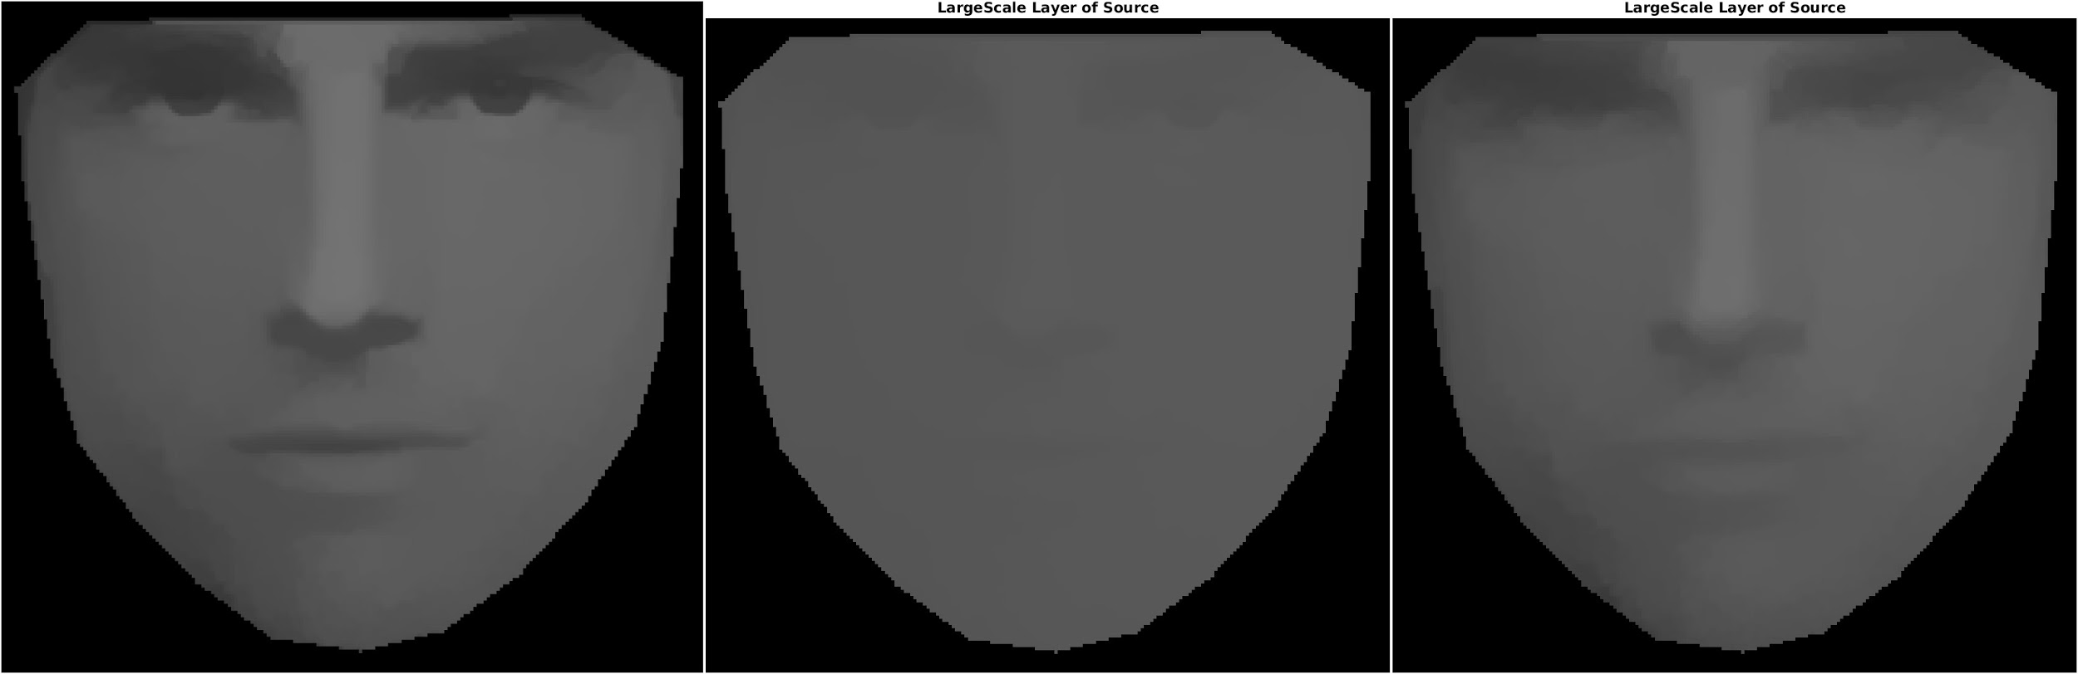
RESULTS OF THE PROJECT (3)
λ=1 λ=4 Adaptive λ
We can clearly observe that λ=1 constant over image doesn’t smooth well because detail areas require more smoothing whereas λ=4 over smoothens causing removal of edges. Adaptive filter here uses small λ over flat regions and significantly large λ over facial hair and eyebrows and gives satisfying results.

Slide 8
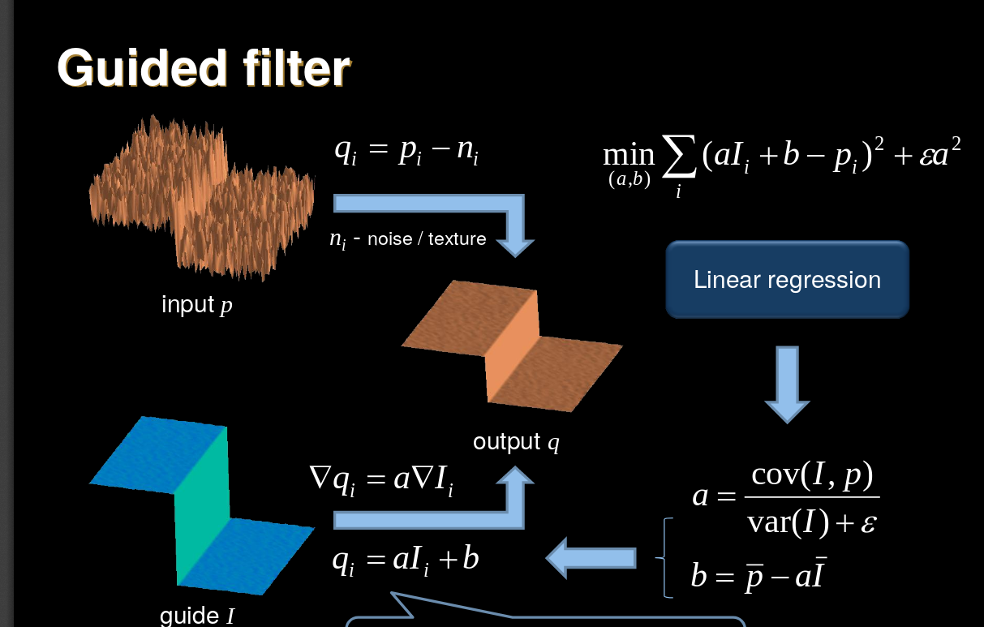
Face Illumination Transfer : Guided Filter

Slide 9
Face Illumination Transfer : Guided Filter
4) Guided Filter :
Guided filter has a key assumption that it is a local linear model between guidance I and filtered output q, as q is the linear transform of I in the window w_{k} centered at the pixel k:
q_{i} = a_{k} I_{i} + b_{k} , ∀i ∈ w_{k}
,where, a_{k} and b_{k} are assumed to be constant in w_{k} .
The linear coefficients a_{k} and b_{k} are determined by minimizing the difference between q and filter input P.
Cost-Function E(a_{k} , b_{k} ) =𝚺((a_{k} I_{i} + b_{k} − P_{i} )² + 𝜺a²_{k} ).
On solving above ridge regression we get a_{k} and b_{k} from which we calculate output image.

Slide 10
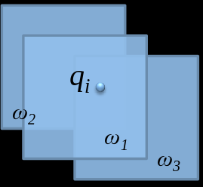
Face Illumination Transfer : Guided Filter contd..
Extend to the entire image:
In all local windows w_{k} compute the linear coefficients.
Compute the average over a_{k}I_{i}+b_{k} in all w_{k} that covers pixel i
q_{i} = 𝚺_{k| iϵw}(a_{k}I_{i}+b_{k})/|w|

Slide 11
FINAL STEP
Filter the reference large-scale layer with the guidance of the target large-scale layer by using guided filter
Desired target lightness is achieved by compositing the filtered reference large-scale layer and the target detail layer.
We get the relit result by incorporating the color information of the target face.
Observations
Our method with guided filter stresses that the relit result with the target image in local window can preserve the linear model and maintain better identification characteristics of the target face.

Slide 12
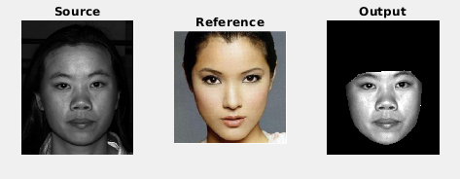
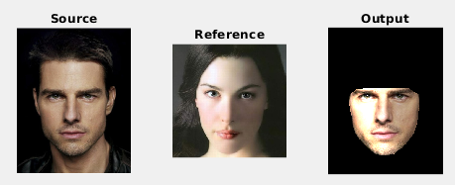
RESULTS

Slide 13
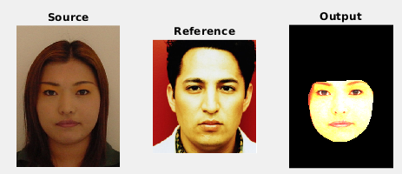
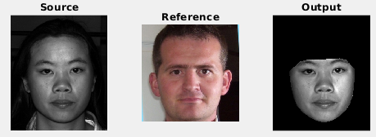
RESULTS

Slide 14
DIVISION OF WORK
Work Item | Major Contributor
Morphing | Soorya
Gradient Generation | Snehith
Adaptive WLS Filter | Snehith
Guided Filter | Soorya + Snehith
Debugging and Misc. | Soorya

